Slide 1
Woodstock Open Space & Farmland Preservation Committee
Protecting Woodstock’s Rural Culture
Saving Land
Saving Taxes

Slide 2
Woodstock Open Space & Farmland Preservation Committee History
Established in 1999 by town ordinance and charged with recommending properties to be protected through conveyance or conservation easements in compliance with Plan of Conservation & Development.
Members meet privately with landowners to discuss conservation options.
State conservation goals are 22% of total acreage. Woodstock currently has protected less than 10%.

Slide 3
Who We Are: Membership 2020
Committee members serve at the pleasure of the Board of Selectmen and represent numerous town boards and commissions:
Crystal Adams – Conservation Commission Rep
Dawn Adiletta – Chair and member at Large
Syd Blodgett – Secretary and Planning & Zoning Rep
Charlene Cutler – Board of Finance Rep
George French – member at large
Roger Gale – member at large
Amy Monahan – Recreation Commission Rep
Stewart Morse – Agriculture Commission Rep
Chandler Paquette – Board of Selectmen Rep

Slide 4
Woodstock Protected Farms
Thanks to the foresight of numerous Woodstock farm families and the preservation programs of Connecticut Department of Agriculture (CT DoAG) and the Natural Resources Conservation Service (NRCS) Woodstock has 17 protected farms. The town has partnered on five (5) of those projects.
We are moving forward with the next project, the purchase of development rights of Maplecrest Farm.

Slide 5
Maplecrest Farm
2020
Protecting 140 acres of farmland

Slide 6
Proposal: Purchase the Development Rights of Maplecrest Farm in partnership with the CT Department of Agriculture.
Property: Maplecrest Farm on Route 169
Owners: Timothy, Wendy, Lucas, and Angela Young.
Acreage: approximately 140 acres
Cost to town: no more than $65,000
Open Space Fund has necessary monies.
THERE WILL BE NO INCREASE TO THE BUDGET

Slide 7
Where is Maplecrest Farm?

Slide 8
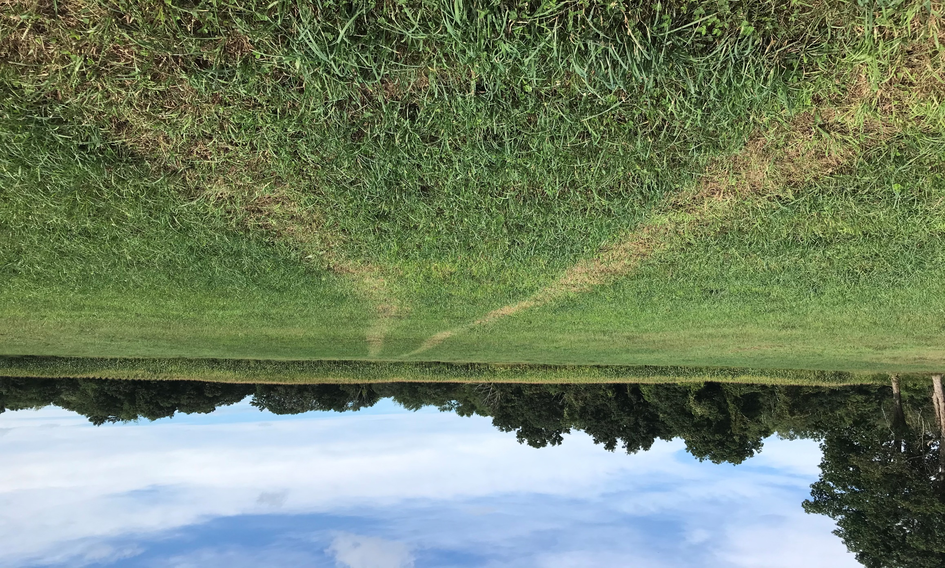
Where is Maplecrest Farm?
Maplecrest Farm has frontage on 169, south of the Christmas Barn, and abuts Valleyside Farm to the east.
This project does NOT include the Maplecrest barn and house lot.

Slide 9
Why Protect Farmland?
Protecting local farmland protects the ability to provide a local supply of food
Protection contributes to local quality of life
Protection supports wildlife and habitat
Protection supports other local farmers by helping to maintain a vibrant agricultural community

Slide 10
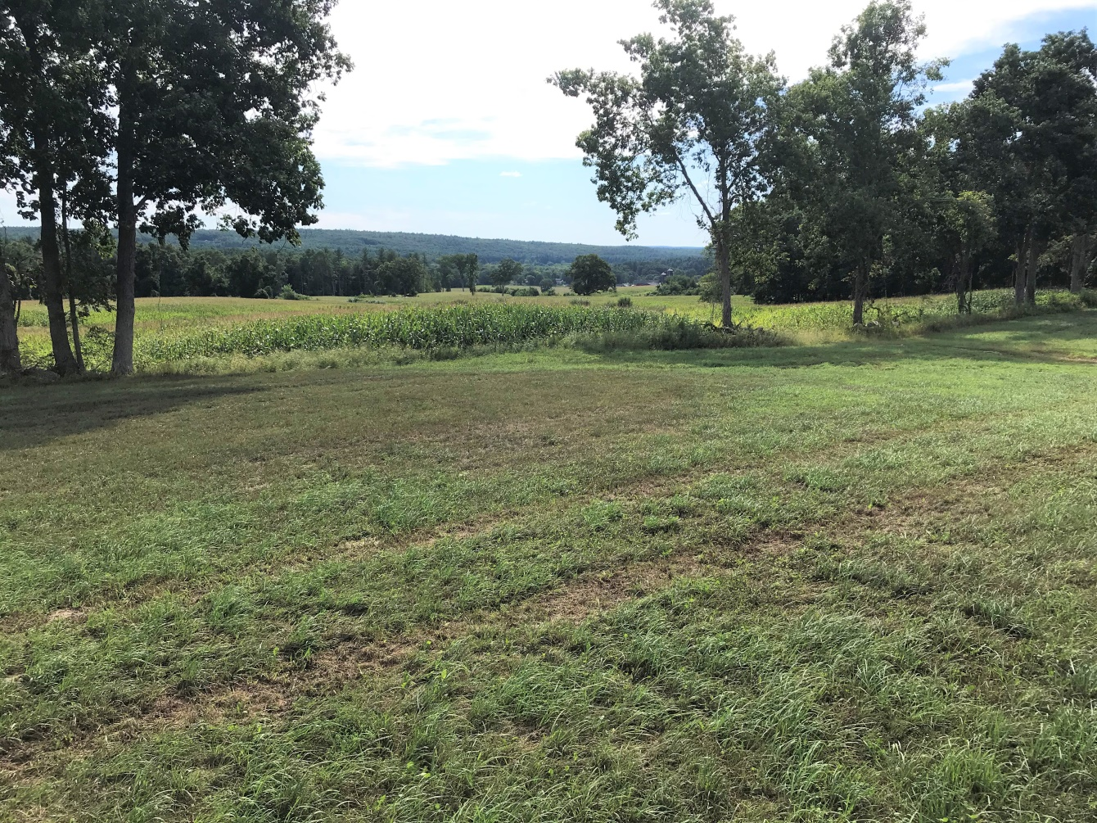
Saving Land Saves Taxes

Slide 11
Farmland Protection Helps Control Local Taxes
Studies show that tax revenue on open space, in general, and farmland in particular, subsidizes other town costs. Nationally, the open-space/working farmland average cost is 36 cents of services required for every $1 of tax revenue generated. Nationally, residential unit average cost is $1.15 of services required for every $1 of tax revenue generated.

Slide 12
Maplecrest Farm is currently owned by the Young family and contributes to their home farm, Valleyside Farm. Protecting this property is part of their sustainability plan.

Slide 13
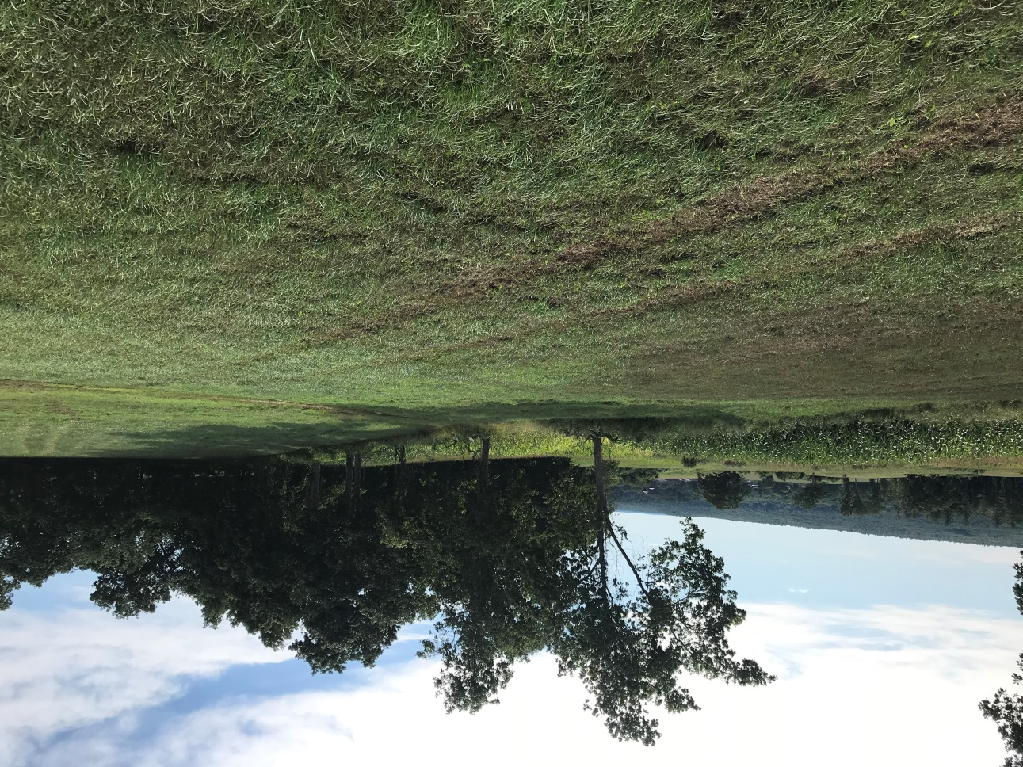
Maplecrest Farm
140 +/- Acres
111 Acres of prime and important agricultural soils
Currently supports Valleyside Dairy Farm
Land will remain private
Land will remain on tax rolls

Slide 14
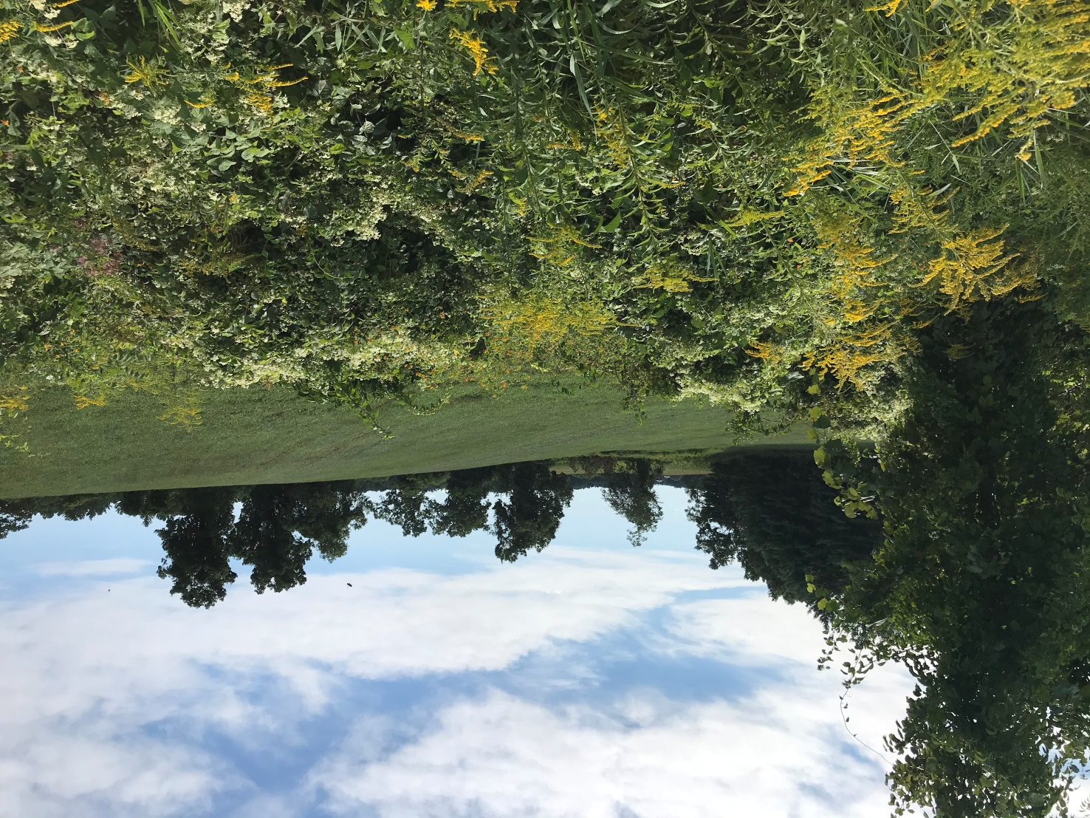
Plan of Conservation and Development
The Woodstock Plan of
Conservation and Development
has identified agricultural land
as a prime conservation
objective.
Protecting Maplecrest Farm
supports that plan.

Slide 15
Where does the money come from?
Most of the conservation costs (75%) will be paid for by CT Department of Agriculture’s Farmland Preservation Program and the NRCS
If approved Woodstock will pay the remaining 25%
Woodstock’s share comes from a special fund – the Open Space Acquisition Fund – funded through the town budget, PA 490 payments, and Fees in Lieu of Open-Space
It may ONLY be used for such projects

Slide 16
Paying for the project
Woodstock will pay for 25% of the conservation costs. The CT Department of Agriculture and NRCS will pay for the rest.
There will be no increase to the town budget.
The Open-Space fund has adequate funds for this project.
The money may ONLY be used for such projects.

Slide 17
What is the Next Step?
Normally this would proceed to a vote at a town meeting
Due to the COVID-19 pandemic and the rising number of cases throughout the region, the Board of Selectmen will move forward with this purchase under Executive Orders 7S.7 and 7CC.1
This allows the Boards of Selectmen and Finance, by a majority vote of each, to approve the purchase of the development rights of Maplecrest Farm in partnership with the State of Connecticut Department of Agriculture
Voting will take place at the December 17th Board of Selectmen meeting and the January 12th Board of Finance meeting
For more information contact the Woodstock First Selectman’s Office at assistant@woodstockct.gov or 860-928-0208 ext. 336

